Slide 1


Everway SDET
Shift-Left Program
August / September 2026

Slide 2

Session timings
Start and finish
13:00 – 17:00
Breaks
14:00 – 14:10
15.50 – 16:00

Slide 3
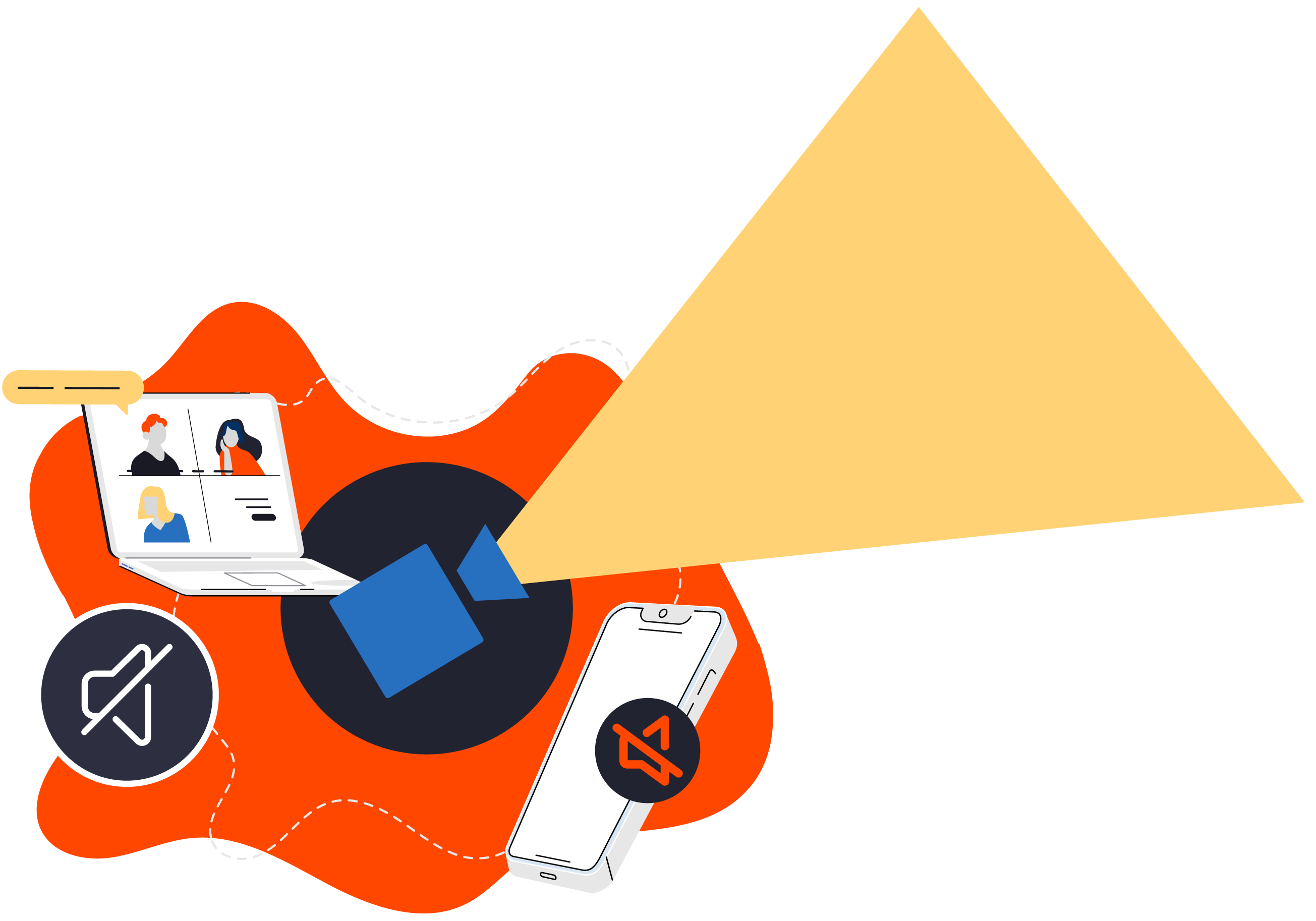
Housekeeping
Feel free to interrupt
the trainer at any
time - you don’t
need to
raise your
hand!
Keep your
camera on
Stay muted
but be ready
to regularly un-
mute and join in
Turn phones to silent, and close your email

Slide 4


Shift-Left Program
What we are going to cover in this program.
Phase 1 – Think like an SDET
Shift-left, quality ownership, Testing Pyramid, Playwright foundations.
API testing with Postman, AI-enabled testing, assessment.
Phase 2 – Engineer a quality solution
Playwright suites, AI in practice, Pact, JMeter.
  Build a broader automated testing strategy rather than simply automate UI tests.
Developer coaching, testability, exploratory testing.
  Operate as an embedded SDET who improves the team’s engineering practices.
Phase 3 - Hackathon
Coming Soon.

Slide 5
Phase 2 Day 4
Developer Coaching in Practice
Designing for Testability
Exploratory Testing as a Craft
Phase 2 Assessment

Slide 6
The SDET as a Quality Advocate
Today's question: What if the best way to improve testing is to change the software?

Slide 7
Recap — Engineering the Signal
When does a fixture improve independence?
What problem should a Page Object solve?
Why is a retry not a flake fix?
What does the NeuroPulse consumer expect from the simulator?
Why might p95 matter more than an average?

Slide 8
Today's Outcomes
By the end, you can:
recognise observable, controllable, deterministic design;
propose a seam for time, randomness, or an external service;
coach a developer through quality-focused review;
create and execute a structured exploratory charter;
communicate a quality risk with evidence and impact.

Slide 9
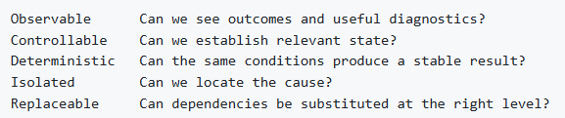
Testability Is a Design Property
Testability improves development feedback—not only test code.

Slide 10
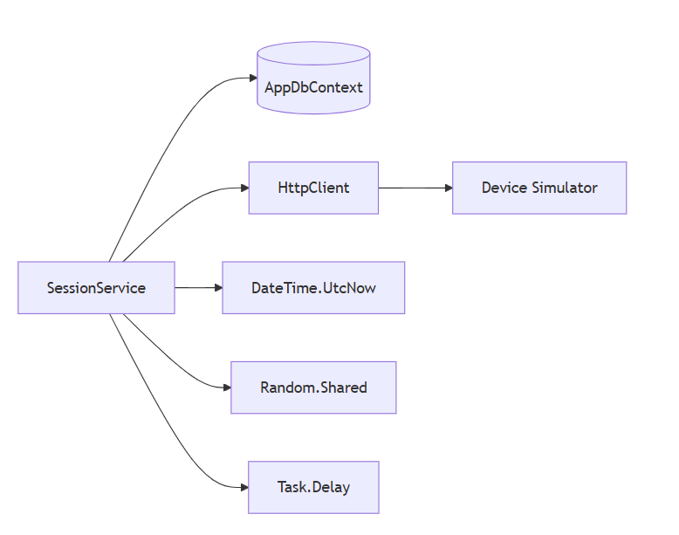
A NeuroPulse Dependency Map
Which dependency controls the test—and which does the test control?

Slide 11

Activity One — Investigate the two problems and pick one.
1: The GitHub codespace doesn't work for everyone.
2: The (src/NeuroPulse.Api/Program.cs) code needs to be refactored but not broken.

Slide 12
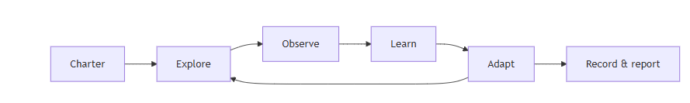
Exploratory Testing Is Structured Engineering
Not: clicking around randomly
Test design and execution happen together.

Slide 13
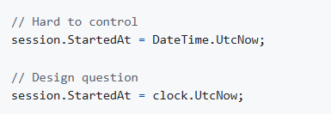
Time Is an Input
How do we test tomorrow, a boundary instant, or elapsed duration?

Slide 14
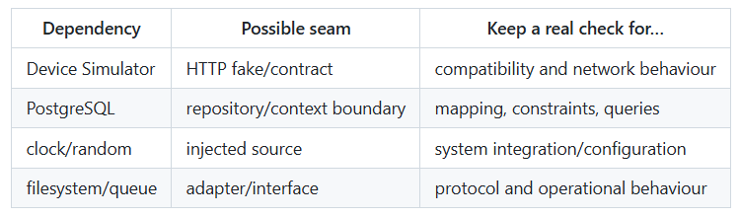
External Dependencies and Test Seams
Mocking increases control; reality increases fidelity. Use both deliberately.

Slide 15
Activity Two — What tests or monitoring or logging can help?
1: The GitHub codespace doesn't work for everyone.
Or
2: The (src/NeuroPulse.Api/Program.cs) code needs to be refactored but not broken.

Slide 16
Quality-Focused Code Review
Ask:
Can I observe the result and the failure?
Can I control important dependencies?
What assumptions are hidden?
What happens concurrently or on repetition?
Can this be tested below the UI?
Does the code preserve domain invariants?

Slide 17
What Changed Your Investigation?
Which observation changed your next action?
Which notes preserve sequence and state?
What did you learn that a script might miss?
Which finding should become an automated check?
Which uncertainty remains?

Slide 18
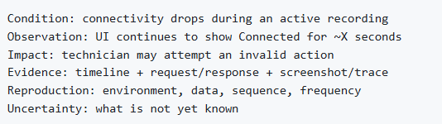
Communicate a Risk, Not “It Broke”

Slide 19
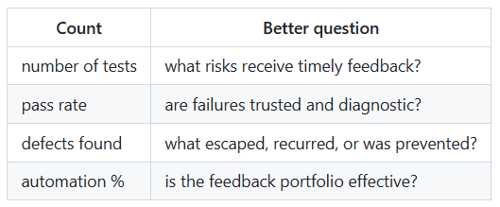
Quality Signals or Vanity Metrics?
Metrics should change a decision.

Slide 20
Activity Three — Prepare a presentation or explanation.
Treat Ray Coulstock as the developer and coach him to understand what can be improved.
Prepare a short presentation or conversation.
Min 2 minutes - Max 5 minutes.

Slide 21
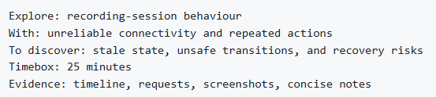
A Useful Charter
Specific enough to focus; open enough to learn.

Slide 22

Small Heuristic Set
Vary and observe:
Heuristics generate questions; they do not guarantee coverage.

Slide 23
Shift-Left Program
What we are going to cover in this program.
Phase 1 – Think like an SDET
Shift-left, quality ownership, Testing Pyramid, Playwright foundations.
API testing with Postman, AI-enabled testing, assessment.
Phase 2 – Engineer a quality solution
Playwright suites, AI in practice, Pact, JMeter.
  Build a broader automated testing strategy rather than simply automate UI tests.
Developer coaching, testability, exploratory testing.
  Operate as an embedded SDET who improves the team’s engineering practices.
Phase 3 - Hackathon
Coming Soon.

Slide 24
Thank you

